Slide 1



JOBIFY

Slide 2


Under Supervision:
Dr: Safi Ibrahim
Eng: Rofida Abdehafez
Professor, Department
of information technology
at National Egyptian E-learning University (EELU)
Teacher Assistant, Department
of information technology at Egytian E-learning University
(EELU)

Slide 3

Team Members
Kariem Hatem Ahmed 21-00850
Sayed Ali Sayed 21-01579
Mayar Essam Mahmoud 21-01049
Shahd Aboelhamd Hamouda 21-01619
Sohila Salem Ali 21-01645
Rahma Essam Adel 21-01453
Sara gamal Awad 21-01574

Slide 4

Introduction
Importance of Jobify
Problem Statement
Problem Solutions
Requirements
Functional Requirements
Non Functional Requirements
Tools
System features
Time plans
Resources
Outline

Slide 5
Introduction

Slide 6

Introduction:
This project is driven by the vision of empowering individuals to take control of their career journeys while helping organizations discover talent. Jobify aspires to be more than just a job board; it aims to be a reliable companion for users as they navigate the complexities of the modern job market. Through innovation and accessibility, Jobify seeks to contribute to a brighter and more connected future for the workforce.

Slide 7
Introduction con.
Jobify is an innovative platform designed to bridge the gap between fresh graduates, entry level professionals, and potential employers. In today’s competitive job market, many job seekers struggle to find opportunities that align with their skills and aspirations, while employers face challenges in identifying suitable talent efficiently. Jobify addresses these issues by providing a user-friendly platform equipped with advanced features to streamline the job search and recruitment process.

Slide 8
Importance of Jobify

Slide 9

Importance of Jobify:
Empowering Job Seekers
User-Centric Design
Reducing Job Search Frustration
Provides users with the tools and resources they need to be proactive in their job search, empowering them to take control of their career path.
Focuses on the needs of fresh graduates and beginners, offering a platform that simplifies the job search process with an intuitive interface and easy navigation.
By offering tailored job listings, Jobify minimizes the overwhelming feeling of sifting through endless irrelevant job postings, making the process less stressful.

Slide 10
Importance of Jobify con.
Enhancing Career Readiness
Improved Job Search Efficiency
Part-Time and Internship Opportunities
With features like resume building tips, interview preparation, and job-seeking strategies, Jobify ensures that users are not just applying for jobs but are ready to succeed in them.
Streamlines the job application process by allowing users to save and apply to multiple jobs with just a few clicks, saving valuable time.
Offers listings for part-time roles and internships, which are ideal for students and fresh graduates looking to gain experience and build their resumes.

Slide 11

Importance of Jobify con.
Optimizing Resume Validity
Job Recommendations
Job Search Analytics
Jobify offers users access to analytics on their job search activity, providing insights on application success rates and engagement with job listings.
Jobify uses AI to analyze resumes, match them with job descriptions, and help users tailor their CVs to increase their chances with employers.
The chatbot can ask users about their skills, qualifications, and preferences, and then suggest relevant job openings in real time.

Slide 12
Problem Statement

Slide 13

Understand the Challenge and issue that face jobify
Lack of User-Centric Search:
Many job platforms have complex search functionalities that confuse users.
Limited Opportunities for Fresh Graduates:
Many job platforms focus primarily on experienced professionals, leaving fresh graduates and entry-level job seekers with few tailored opportunities.
Lack of Beginner-Friendly Job Filters:
Existing platforms often lack filters for entry-level positions, making it difficult for beginners to find roles that match their skill level.

Slide 14
Understand the Challenge and issue that face jobify con.
Mobile Responsiveness Issues:
A significant portion of job seekers uses mobile devices, yet some platforms are not fully optimized for mobile use.
Neglect of Mentorship or Internship Roles:
Few platforms highlight internships, training programs, or mentorship opportunities that can help beginners gain experience.
No Guidance for Career Starters:
There is a lack of features like career advice, interview preparation, or resume-building tools designed for fresh graduates .

Slide 15
Understand the Challenge and issue that face jobify con.
Few Remote or Part-Time Options for Beginners:
Many platforms don’t prioritize flexible job opportunities like remote or part-time roles that fresh graduates might prefer while starting out.
Overwhelming and Complex Interfaces:
Beginners often find existing job platforms difficult to navigate due to cluttered layouts and non-intuitive designs.
Platforms Offering Comprehensive Interview Preparation:
A few platforms have dedicated sections for interview preparation, covering both technical and behavioral aspects.

Slide 16
Problem Solutions

Slide 17

Here we explored and try to innovative solutions to overcome the challenge that faces our platform jobify.
User-Centric Search:
Jobify offers an intuitive and user-friendly search interface with simplified functionalities. Instead of overwhelming users with complex options.
Opportunities for Fresh Graduates:
Jobify focuses on fresh graduates by offering internships, mentorships, and tailored opportunities to help them gain experience and start their careers.
Beginner-Friendly Job Filters:
Jobify makes it easier for beginners to discover suitable opportunities without wasting time on irrelevant listings.

Slide 18
Mobile Responsiveness:
Jobify has fully optimized its platform for mobile devices, recognizing that a significant portion of job seekers browse and apply for jobs on their phones.
Mentorship and Internship Roles:
Jobify added opportunities for mentorship and internship, that can help them build experience and expand their experience.
Career Guidance for Starters:
Jobify understands the unique needs of fresh graduates and offers a variety of career-building tools. These include resume-building assistance, interview preparation resources, and tips for career development.

Slide 19
Remote and Part-Time Options:
Jobify recognizes that many beginners, including fresh graduates, prefer flexible work arrangements like remote or part-time roles. To meet this need, the platform hasn’t forget this for these types of jobs.
Simplified User Interface:
To address the issue of overwhelming and complex interfaces, Jobify has streamlined its design to be clean and intuitive. The platform features a straightforward layout with easy-to-navigate categories

Slide 20
Comprehensive Interview Preparation:
Jobify provides a robust interview preparation section that covers both technical and behavioral aspects. This includes mock interview simulations, practice questions, and expert advice to help job seekers feel prepared and confident for interviews.

Slide 21
Requirements

Slide 22

Functional Requirements
User Registration and Authentication
• Allow users to create accounts and log in using email and password.
• Implement secure authentication with options for password recovery.
Search For Jobs
• Provide search functionality with job type or job name (full-time, part-time, remote, freelance)
Mobile-Responsive Platform
• Ensure the platform is fully optimized for mobile devices, providing a seamless experience for users on all devices.

Slide 23
Functional Requirements con.
Career Guidance Tools
• Include features like a resume builder, interview preparation resources, and career advice sections.
Job Alerts and Notifications
• Provide users with real-time notifications for new job postings that match their preferences.
Flexible Job Options
• Highlight remote, part-time, and freelance opportunities, especially for fresh graduates and entry-level seekers.

Slide 24
Functional Requirements con.
CV Analyzer
• Include a CV analysis tool that evaluates users' resumes and provides feedback on structure, keywords, and areas of improvement.
• Suggest tailored job opportunities based on the analyzed resume.
AI-Powered Chatbot
• Implement a chatbot to assist users with job searches, application processes, platform navigation, and career advice.
Interview Preparation Section
• Include comprehensive resources for technical and behavioral interview preparation, such as mock interview and practice questions.

Slide 25




Non Functional Requirements
Performance
The platform should handle users with minimal latency, and job searches should return results within few seconds.
Scalability
The system should scale to support growing user traffic and data as the platform expands.
Security
Implement robust encryption for user data, secure authentication, and protection against common vulnerabilities

Slide 26

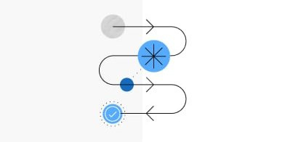
Non Functional Requirements
Usability
The platform should be intuitive and easy to use for users of all experience levels, Provide consistent design and user-friendly navigation across desktop and mobile devices.
Responsiveness
Ensure full optimization for all devices, including desktops, tablets, and smartphones, with a mobile-friendly design.
Availability
Guarantee 99.9% uptime with failover mechanisms and backup systems to maintain reliability.

Slide 27
Tools

Slide 28




Frontend Development
Angular
Bootstrap 5
FontAwesome

Slide 29


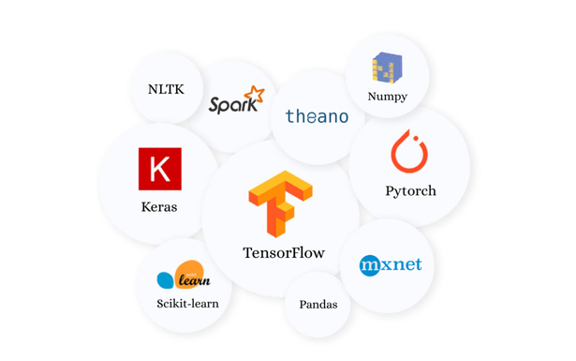
AI and Machine Learning
Python
Machine Learning Libraries

Slide 30


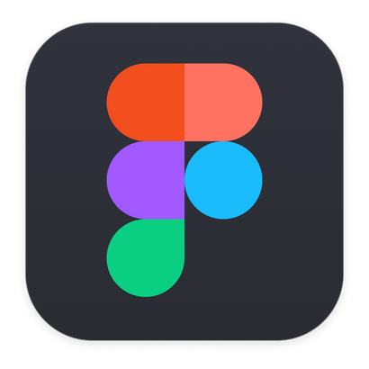
Backend Development
.NET Framework
Design and Prototyping
Figma

Slide 31
System features

Slide 32
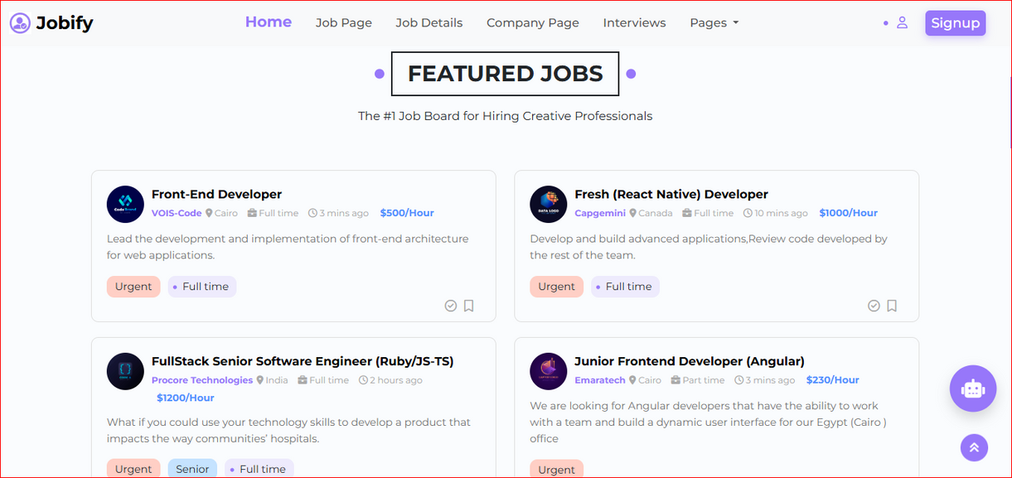
Home Page Overview
Featured Jobs Section:
This section displays a selection of highlighted job listings.It showcases various available positions to attract users and help them quickly find appealing opportunities.

Slide 33
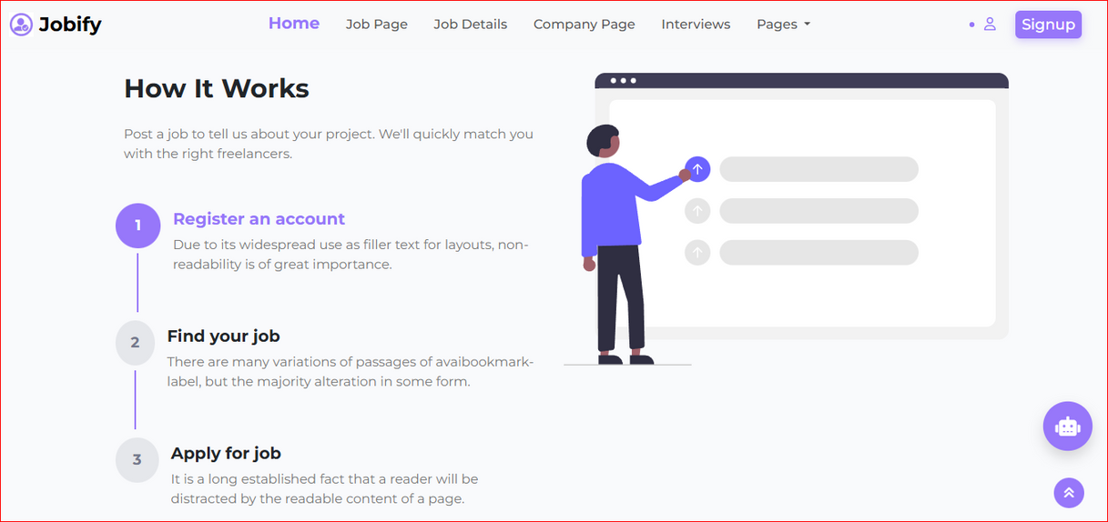
How It Works Section:
This part explains how the website functions. It guides users through the process of:
Searching for suitable job opportunities
Applying for jobs directly through the platform
Understanding how the platform connects job seekers with employers

Slide 34
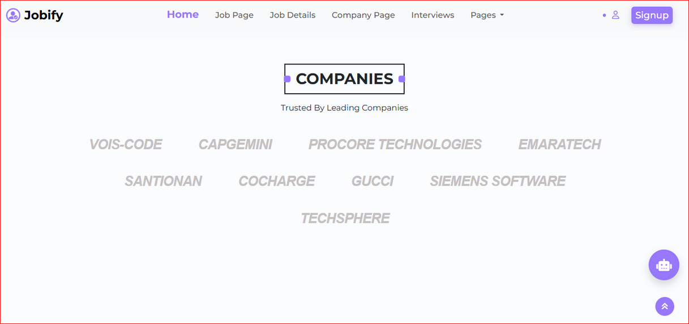
Companies Section:
A dedicated area that lists several well-known companies currently operating in the market. It helps users explore potential employers and learn more about the companies offering job opportunities.

Slide 35
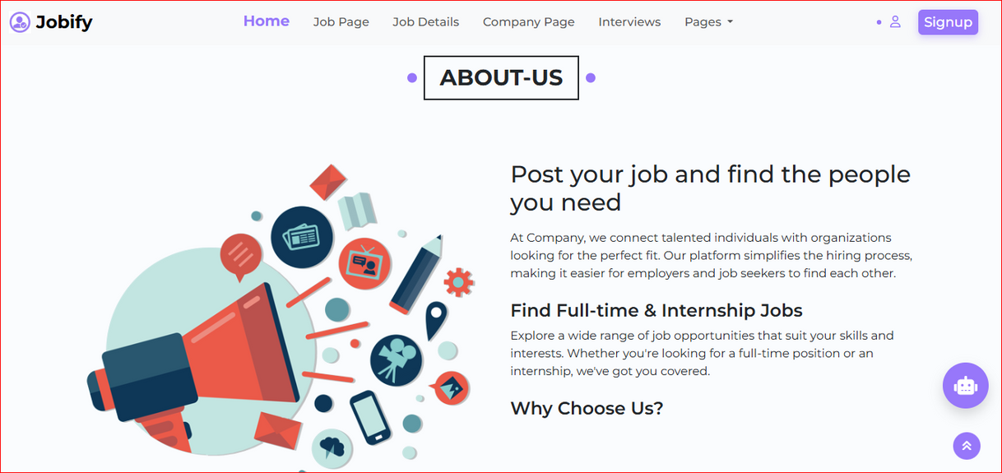
About Us Section:
This section provides information about the platform itself, its mission, vision, and the team behind the service. It helps build trust and transparency with the users.

Slide 36

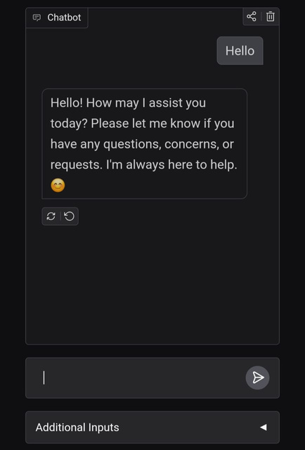
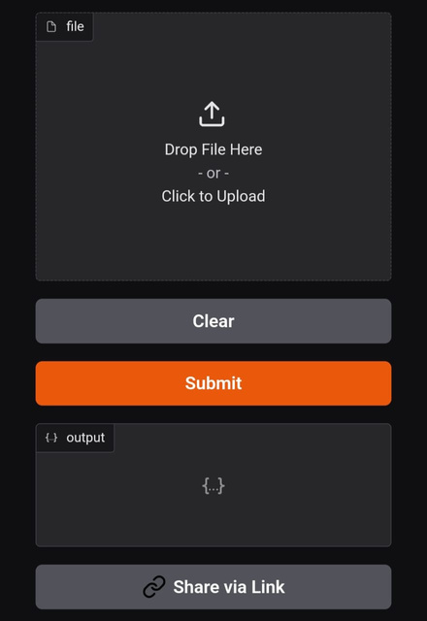
ChatBot:
Cv Analyser:
The role of a chatbot is to engage with users in real-time, understand their queries, provide relevant responses, and assist in tasks or troubleshooting, enhancing customer support and user experience.
The role of a CV Analyser is to review and analyze candidates' resumes, extract relevant skills and experiences for various positions, and provide an accurate assessment to assist in the hiring decision process.

Slide 37
System Design
Presentation Layer: Frontend development using Angular and Bootstrap for a responsive and user-friendly interface.
Business Logic Layer: Backend services built with .NET Core to handle APIs, authentication, and business logic.
Data Layer: Use SQL Server to store user accounts, job listings, CVs, and application data.

Slide 38
Designs (Prototype)

Slide 39
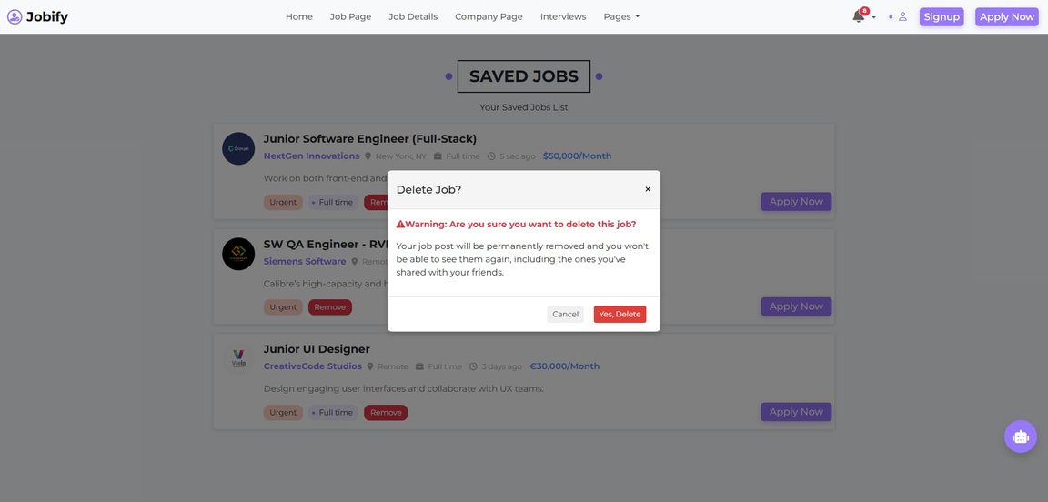
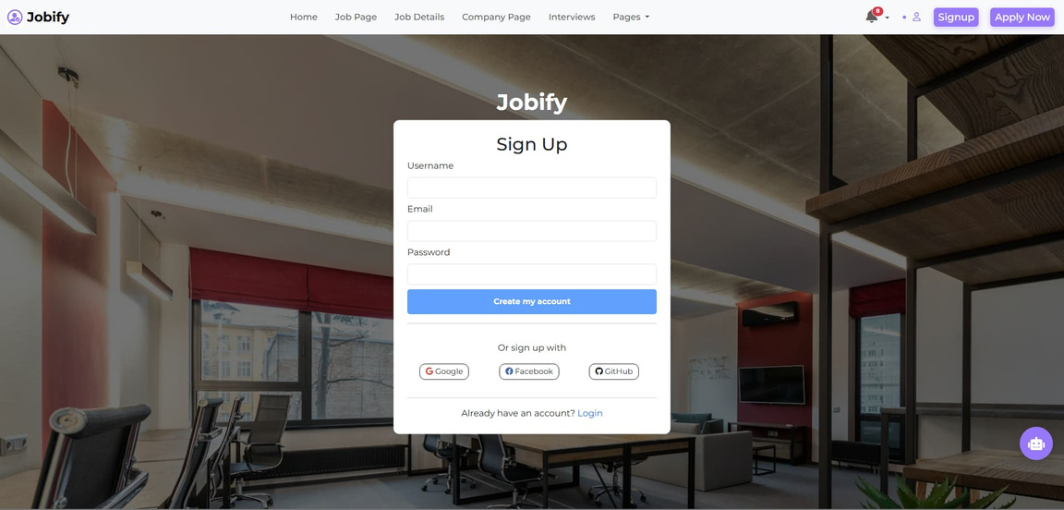
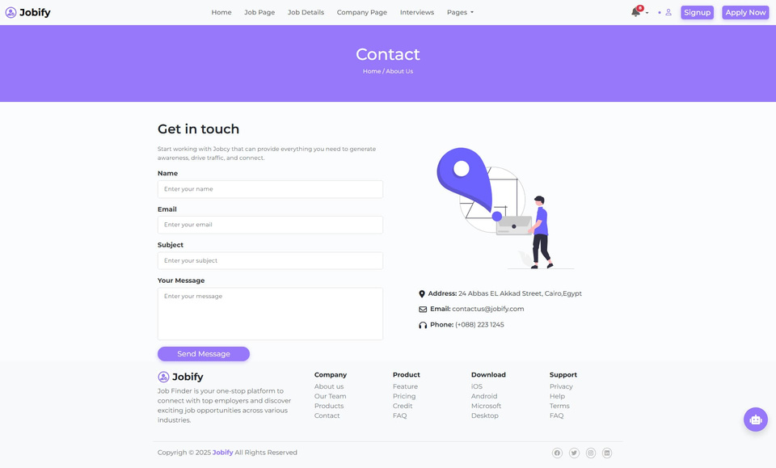
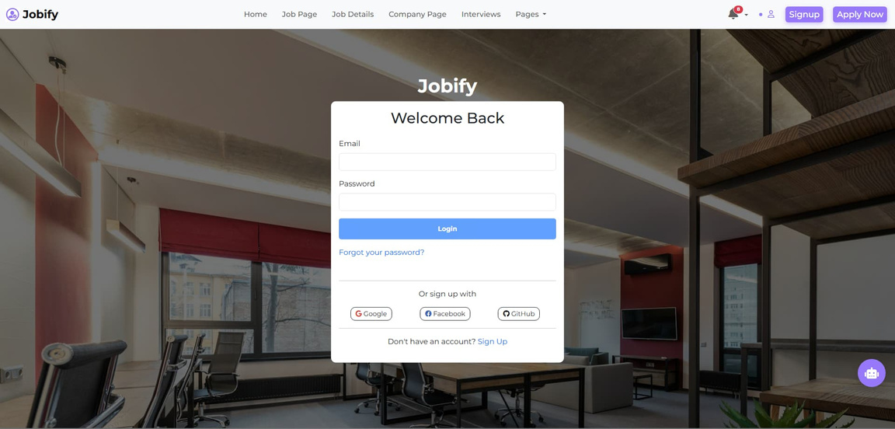

Slide 40
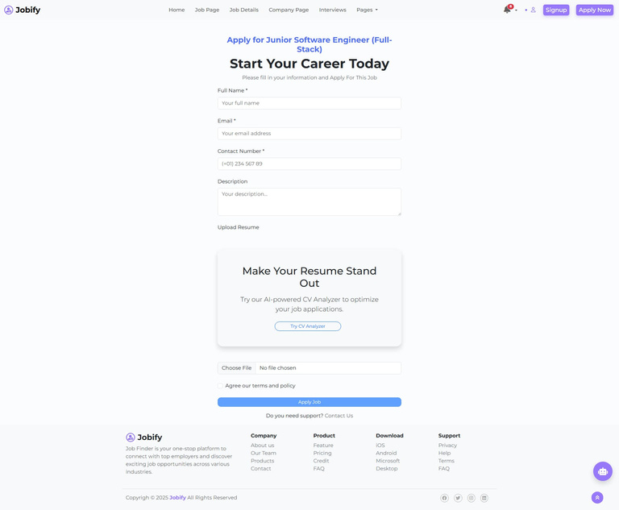
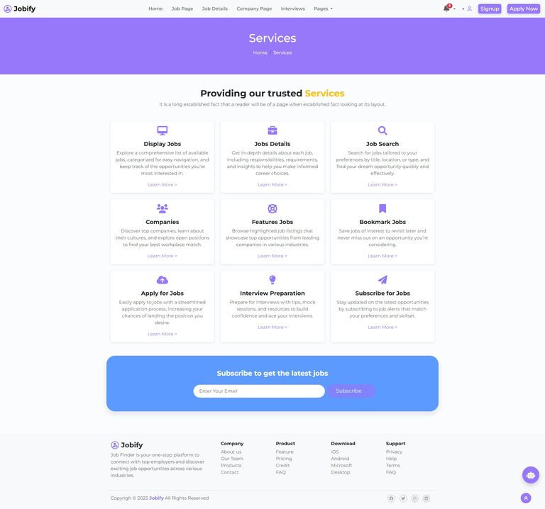
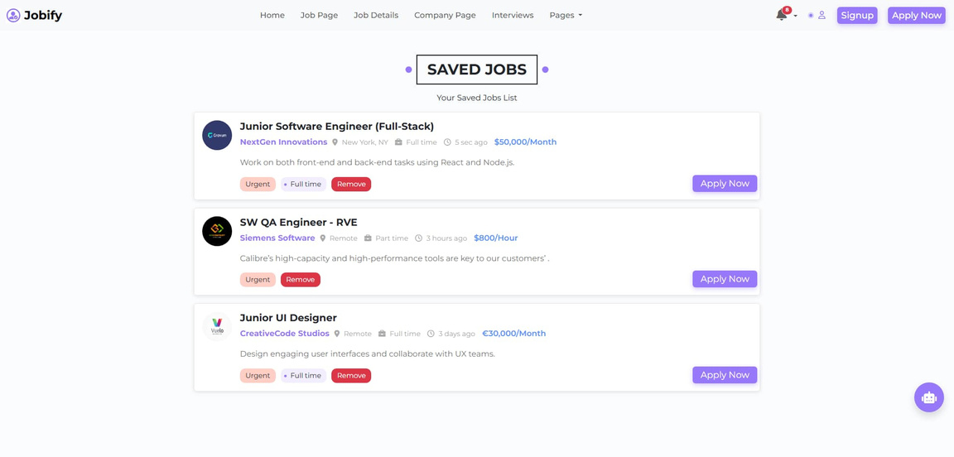
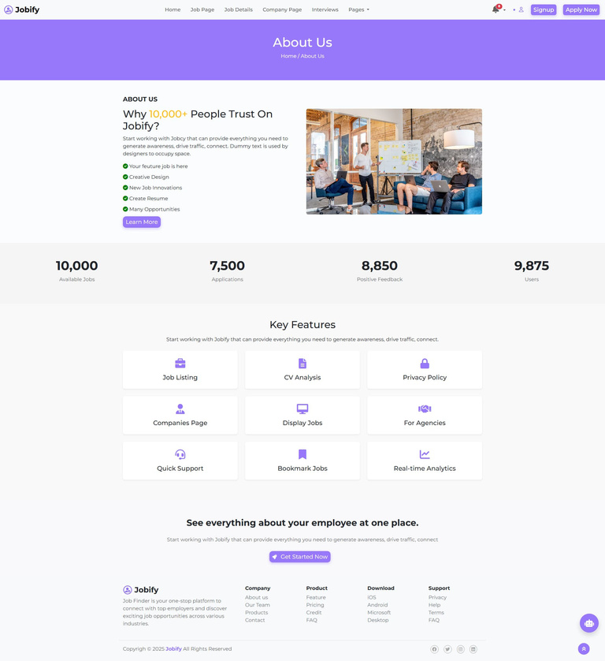
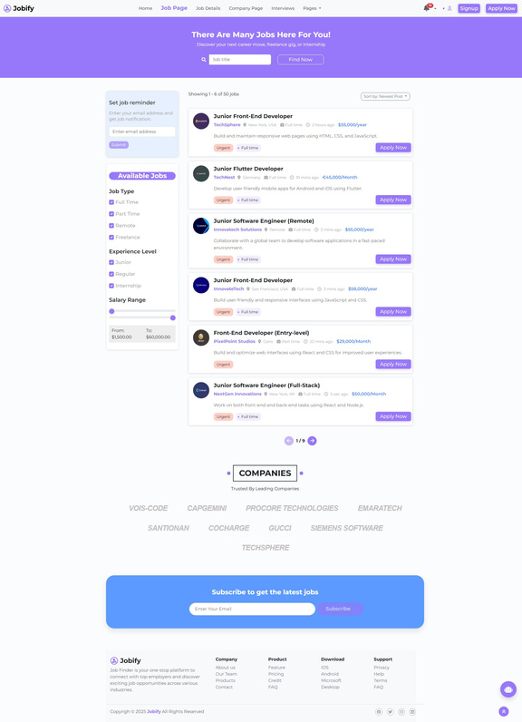
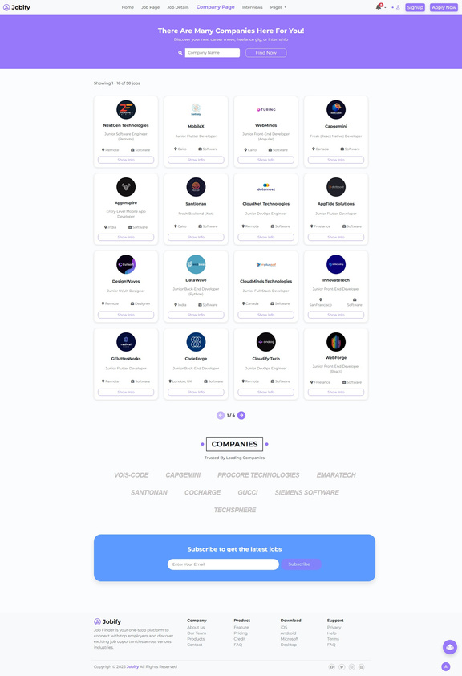

Slide 41
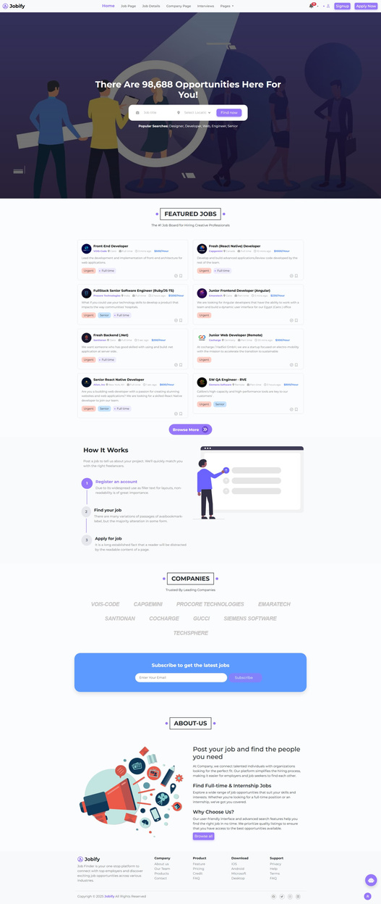
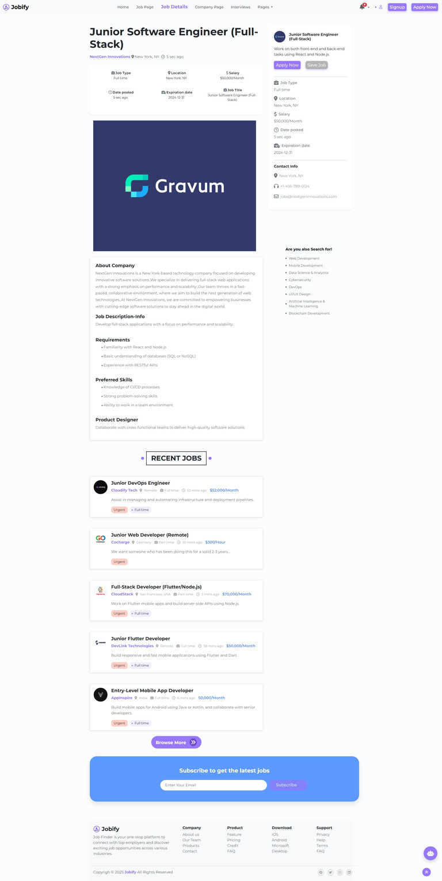
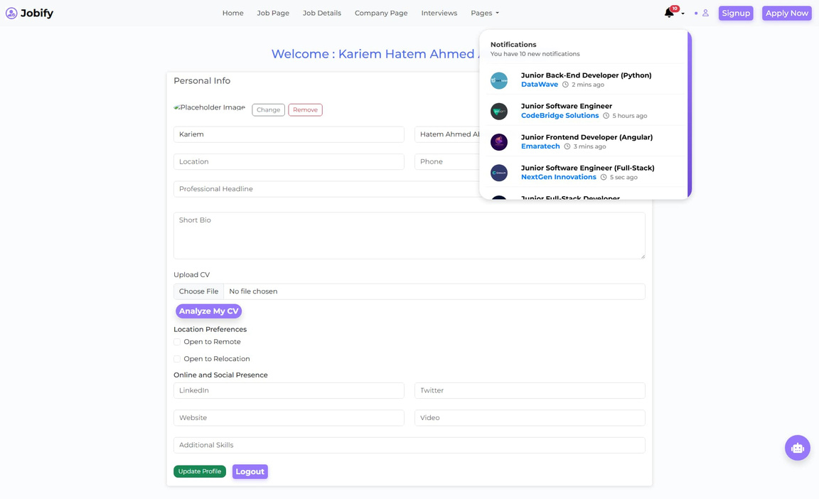

Slide 42
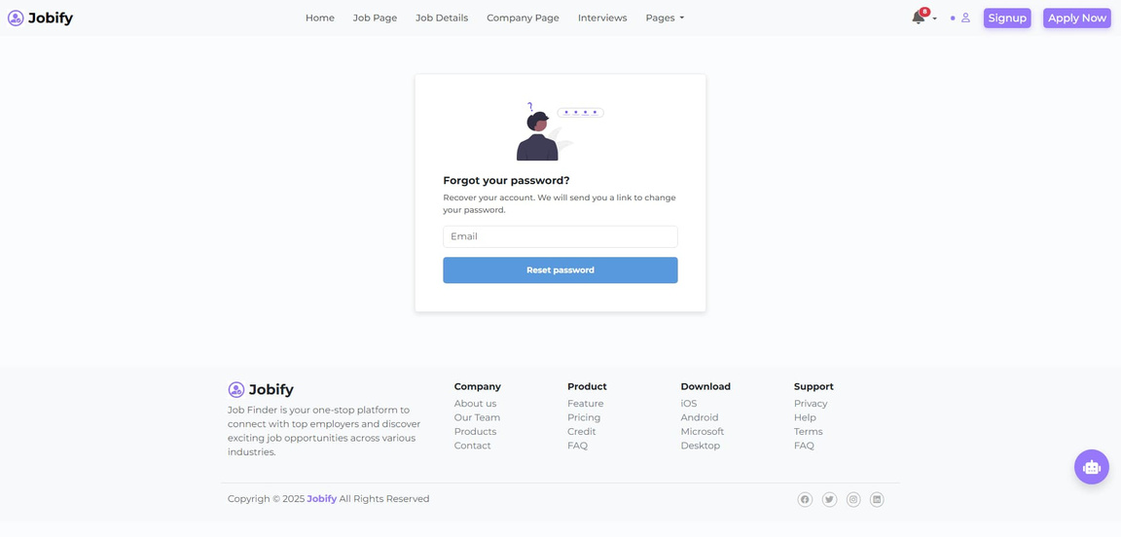
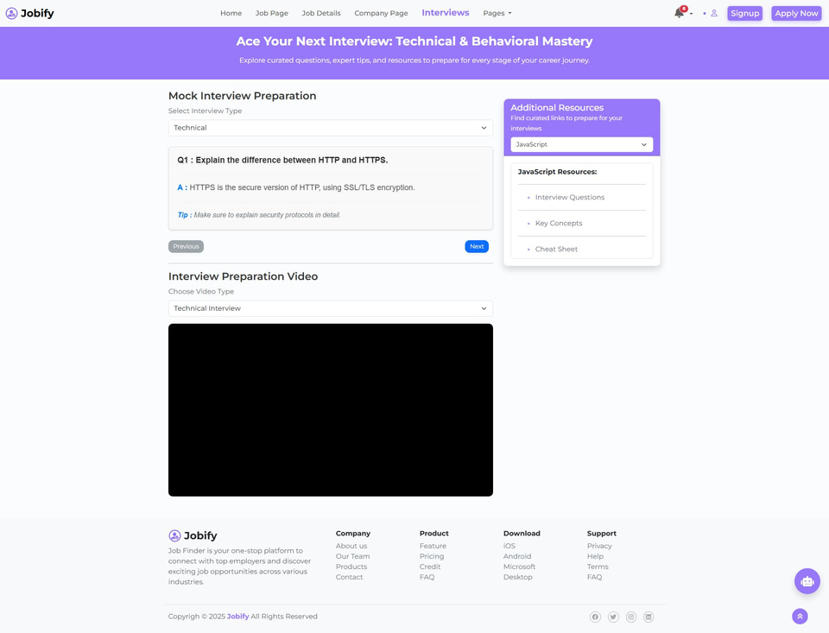

Slide 43

Machine Learning Integration
Python for implementing machine learning models:
AI-powered CV Validation: Use (IPython,IPython.display,pandas,google.colab sklearn,numpy,matplotlib.pyplot,re,pickle,os,pdfminer.six)
for analyzing and validating resumes based on
job requirements, highlighting strengths and
areas for improvement.
Integration:
Connect Angular frontend with .NET backend APIs.
Integrate Python ML services into the backend.

Slide 44


(cv analyser models and datasets):
Resume Categorization with Random Forest
Goal: Categorize resumes using text analysis.
Steps:
Preprocessed 3 datasets and used TF-IDF.
Achieved 96% testing accuracy.
Added a prediction function for new resumes.
Extracted Info and Hiring Process
Imports: pdfminer.six, re, get_ipython.
Extraction: Extracts phone, email, skills, education, and name using regex.
Functions: Dedicated functions for each data type.
Output: Prints extracted info or notes missing data.
Resume Job Recommendation System
Data: Loaded and preprocessed job descriptions using TF-IDF.
Model: Trained Random Forest, achieving 98% accuracy.
Function: job_recommendation predicts the best job role from resume text.

Slide 45

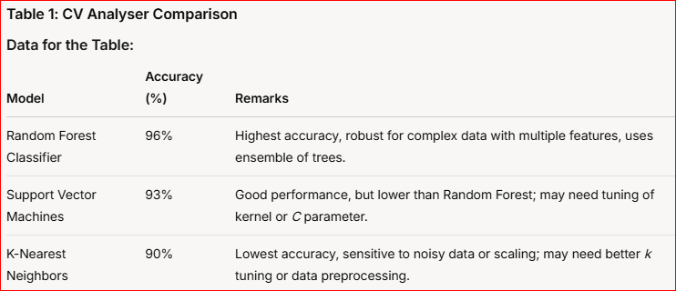
Comparison between the models we used:

Slide 46
(Chat Bot)
Smart Career Chatbot – Your Personal Job Search Assistant
Our AI-powered chatbot is here to support you throughout your career journey. Whether you're looking for your first job or planning your next move, it provides instant help, answers to your questions, and personalized guidance based on your goals.
Accessible to everyone, anytime – it’s your reliable career companion, helping you make smarter decisions with confidence.

Slide 47
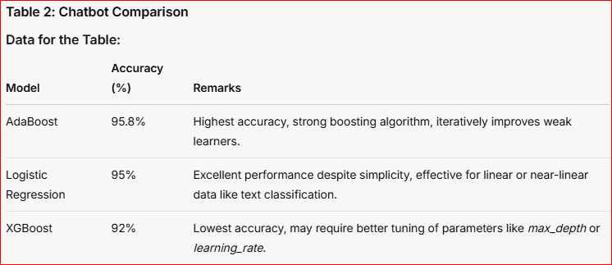
Comparison between the models we used:

Slide 48
Operations

Slide 49
Operations
1.Design & Implementation
(All missions in our website):
Sign up
(Completed)
Cv analyzer
(Completed)
(Completed)
Login
ChatBot
(Completed)
(Completed)
Forget password
(Completed)
Profile page
(Completed)
Home page
Job listing
Job details
Companies
Interview
Saved jobs
Notifcations
Apply now
About us
Contact us
Services
Not found
(Completed)
(Completed)
(Completed)
(Completed)
(Completed)
(Completed)
(Completed)
(Completed)
(Completed)
(Completed)
(Completed)

Slide 50
Time plans

Slide 51
Week
Activity
Main Tasks
Study & Analysis
Research job finder platforms, technologies (Angular, .NET, Python), and user needs.
1-3
Design & Developments
Finalize system architecture, wireframes, and database schema.
4-5
(First Semester)
6-8
Design & Developments
Develop UI mockups and initial frontend pages (Home, Login, Job Listings).
Implementation
Set up development environment, implement basic authentication (Login, Sign-Up).
9-11
Validation & Feedback
Present progress , gather feedback, and refine designs.
12-13
1-3
Design & Developments
Implement all pages (Job Details, etc.).
4-5
Backend Development
Build APIs for job listings, job details, notifications, and other applications.
(Second Semester)
6-8
Machine Learning Integration
Implement job chatbot.
Integration & Testing
Integrate frontend and backend services, test features (job search, job application)
9-11
Deployment & Final Review
Deploying, finalize documentation, and prepare for final presentation.
12-13

Slide 52
Demo video

Slide 53
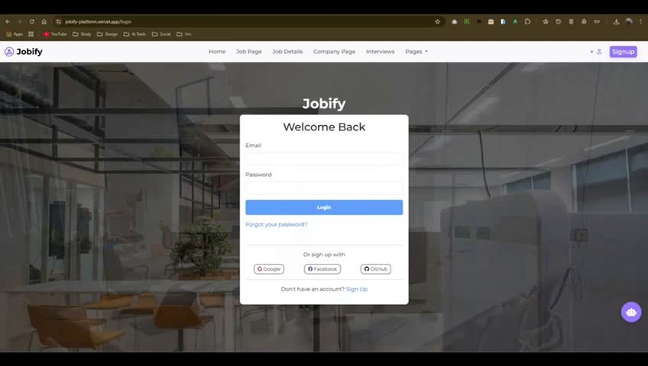

Slide 54
Resources

Slide 55

Resources :
https://getbootstrap.com/
https://fontawesome.com/
https://www.kaggle.com/
https://dribbble.com/
https://www.pinterest.com/
https://www.pexels.com/
https://databasecamp.de/ki/adaboost
https://xgboost.readthedocs.io/en/stable/
https://scikit-learn.org/stable/modules/svm.html
https://angular.io/docs https://docs.microsoft.com/en-us/aspnet/core/
https://machinelearningmastery.com/k-nearest-neighbors-for-machine-learning/
https://towardsdatascience.com/understanding-logistic-regression-9b02c2aec102
https://www.geeksforgeeks.org/random-forest-algorithm-in-machine-learning/

Slide 56


Thank you

